Slide 1

Hi-Landers Ham Class
Instructed by Rich Bugarin W6EC

Slide 2
Sub-element 3 of 10

Slide 3
Ham Radio Technician Class Exam preparation Power Point created by Rich Bugarin W6EC.
Effective July 1, 2022 and is valid until June 30, 2026.
Please send suggested changes to this presentation to:
w6ec@thebugarins.com

Slide 4
Study Hints
I suggest you read each question and only the correct answer. Read through the complete question pool at least three times before you attempt taking a practice exams. For higher impact and better results read the correct answer first then the question and again the correct answer.
The key to passing the exam is to get the most questions correct using the above method the correct response will often jump out at you on test day even if you don’t remember the question.

Slide 5
Text Color
Black: Original/Official questions and information in original format (unaltered).
Red: Original information text color simply changed to highlight subject.
Blue: Notes and information added by Rich (W6EC).

Slide 6
SUBELEMENT T3 – RADIO WAVE PROPAGATION – [3 Exam Questions - 3 Groups]
[3 Exam Questions - 3 Groups]

Slide 7
T3A - Radio wave characteristics: how a radio signal travels, fading, multipath, polarization, wavelength vs absorption; Antenna orientation
#10 of 35

Slide 8
T3A01
Why do VHF signal strengths sometimes vary greatly when the antenna is moved only a few feet?
A. The signal path encounters different concentrations of water vapor
B. VHF ionospheric propagation is very sensitive to path length
C. Multipath propagation cancels or reinforces signals
D. All these choices are correct

Slide 9
T3A01
Why do VHF signal strengths sometimes vary greatly when the antenna is moved only a few feet?
A. The signal path encounters different concentrations of water vapor
B. VHF ionospheric propagation is very sensitive to path length
C. Multipath propagation cancels or reinforces signals
D. All these choices are correct
( See next slide)

Slide 10
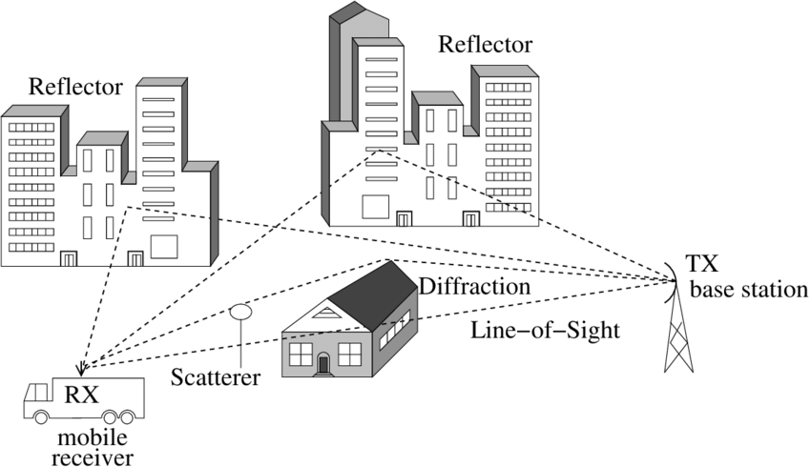
Multipath Propagation

Slide 11
T3A02
What is the effect of vegetation on UHF and microwave signals?
A. Knife-edge diffraction
B. Absorption
C. Amplification
D. Polarization rotation

Slide 12
T3A02
What is the effect of vegetation on UHF and microwave signals?
A. Knife-edge diffraction
B. Absorption
C. Amplification
D. Polarization rotation
Low-frequency radio waves travel easily through obstructions as the frequency increases so does the amount of absorption.

Slide 13
T3A03
What antenna polarization is normally used for long-distance CW and SSB contacts on the VHF and UHF bands?
A. Right-hand circular
B. Left-hand circular
C. Horizontal
D. Vertical

Slide 14
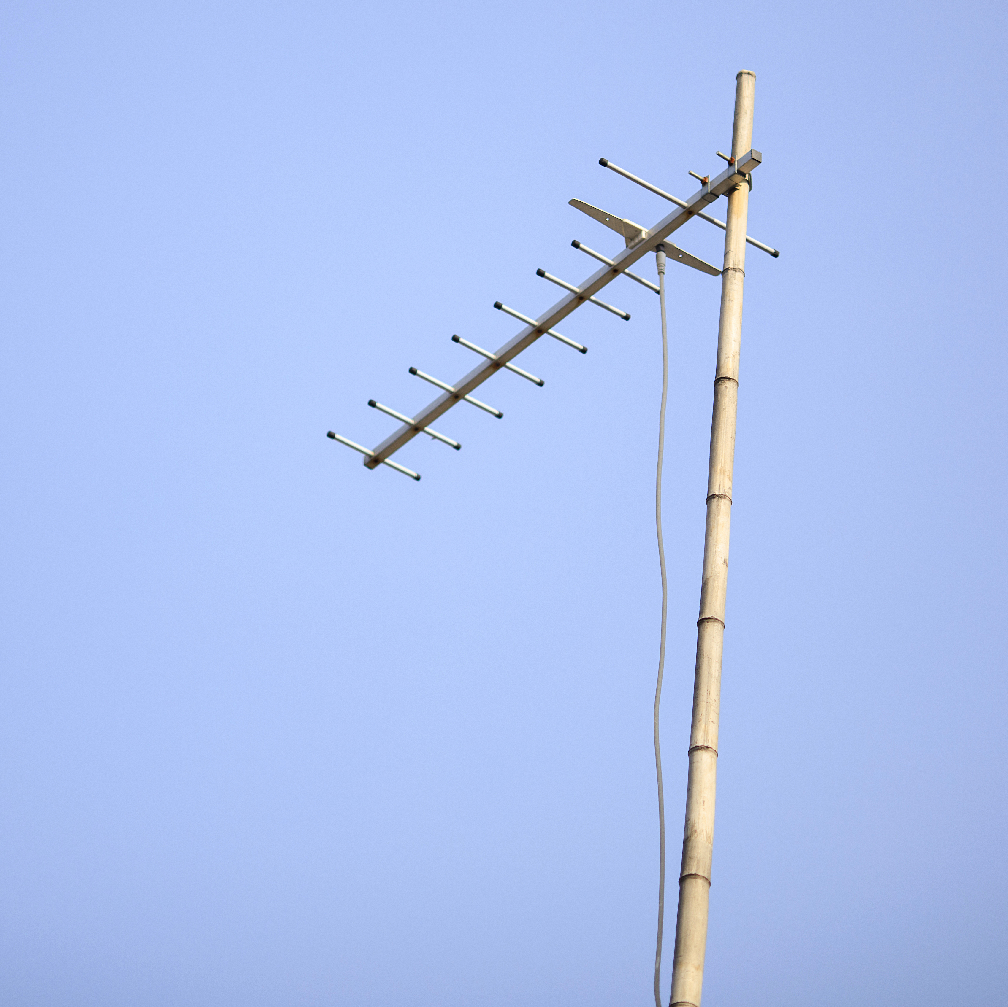
T3A03
What antenna polarization is normally used for long-distance CW and SSB contacts on the VHF and UHF bands?
A. Right-hand circular
B. Left-hand circular
C. Horizontal
D. Vertical

Slide 15
T3A04
What happens when antennas at opposite ends of a VHF or UHF line of sight radio link are not using the same polarization?
A. The modulation sidebands might become inverted
B. Received signal strength is reduced
C. Signals have an echo effect
D. Nothing significant will happen

Slide 16
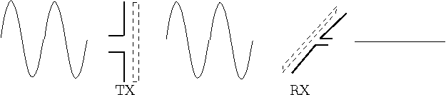
T3A04
What happens when antennas at opposite ends of a VHF or UHF line of sight radio link are not using the same polarization?
A. The modulation sidebands might become inverted
B. Received signal strength is reduced
C. Signals have an echo effect
D. Nothing significant will happen

Slide 17
T3A05
When using a directional antenna, how might your station be able to communicate with a distant repeater if buildings or obstructions are blocking the direct line of sight path?
A. Change from vertical to horizontal polarization
B. Try to find a path that reflects signals to the repeater
C. Try the long path
D. Increase the antenna SWR

Slide 18
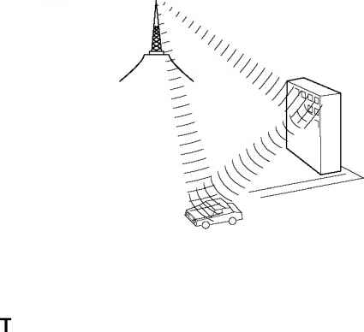
T3A05
When using a directional antenna, how might your station be able to communicate with a distant repeater if buildings or obstructions are blocking the direct line of sight path?
A. Change from vertical to horizontal polarization
B. Try to find a path that reflects signals to the repeater
C. Try the long path
D. Increase the antenna SWR

Slide 19
T3A06
What is the meaning of the term “picket fencing”?
A. Alternating transmissions during a net operation
B. Rapid flutter on mobile signals due to multipath propagation
C. A type of ground system used with vertical antennas
D. Local vs long-distance communications

Slide 20
T3A06
What is the meaning of the term “picket fencing”?
A. Alternating transmissions during a net operation
B. Rapid flutter on mobile signals due to multipath propagation
C. A type of ground system used with vertical antennas
D. Local vs long-distance communications

Slide 21
T3A07
What weather condition might decrease range at microwave frequencies?
A. High winds
B. Low barometric pressure
C. Precipitation
D. Colder temperatures

Slide 22
T3A07
What weather condition might decrease range at microwave frequencies?
A. High winds
B. Low barometric pressure
C. Precipitation
D. Colder temperatures

Slide 23
T3A08
What is a likely cause of irregular fading of signals propagated by the ionosphere?
A. Frequency shift due to Faraday rotation
B. Interference from thunderstorms
C. Intermodulation distortion
D. Random combining of signals arriving via different paths

Slide 24
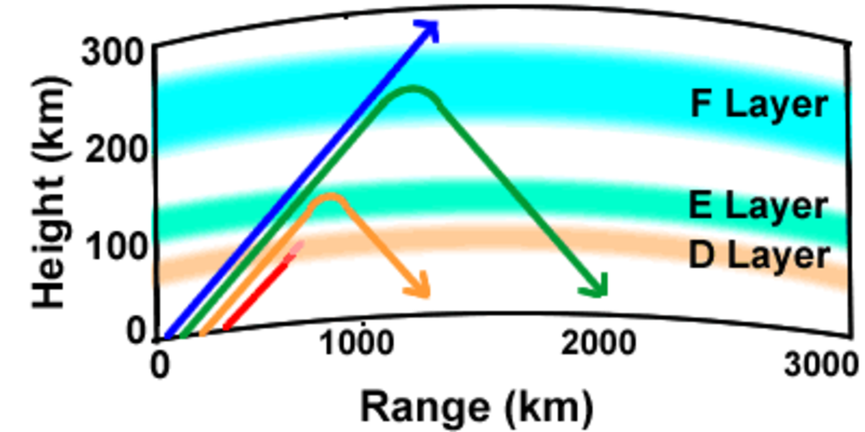
T3A08
What is a likely cause of irregular fading of signals propagated by the ionosphere?
A. Frequency shift due to Faraday rotation
B. Interference from thunderstorms
C. Intermodulation distortion
D. Random combining of signals arriving via different paths

Slide 25
T3A09
Which of the following results from the fact that signals propagated by the ionosphere are elliptically polarized?
A. Digital modes are unusable
B. Either vertically or horizontally polarized antennas may be used for transmission or reception
C. FM voice is unusable
D. Both the transmitting and receiving antennas must be of the same polarization

Slide 26
T3A09
Which of the following results from the fact that signals propagated by the ionosphere are elliptically polarized?
A. Digital modes are unusable
B. Either vertically or horizontally polarized antennas may be used for transmission or reception
C. FM voice is unusable
D. Both the transmitting and receiving antennas must be of the same polarization

Slide 27
T3A10
What effect does multi-path propagation have on data transmissions?
A. Transmission rates must be increased by a factor equal to the number of separate paths observed
B. Transmission rates must be decreased by a factor equal to the number of separate paths observed
C. No significant changes will occur if the signals are transmitted using FM
D. Error rates are likely to increase

Slide 28
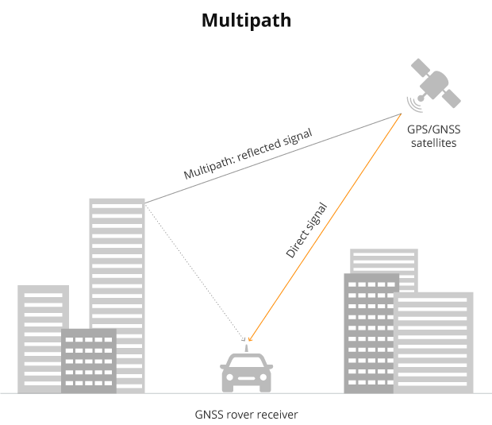
Multi-Path Propagation

Slide 29
T3A10
What effect does multi-path propagation have on data transmissions?
A. Transmission rates must be increased by a factor equal to the number of separate paths observed
B. Transmission rates must be decreased by a factor equal to the number of separate paths observed
C. No significant changes will occur if the signals are transmitted using FM
D. Error rates are likely to increase

Slide 30
T3A11
Which region of the atmosphere can refract or bend HF and VHF radio waves?
A. The stratosphere
B. The troposphere
C. The ionosphere
D. The mesosphere

Slide 31
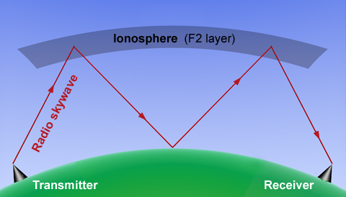
T3A11
Which region of the atmosphere can refract or bend HF and VHF radio waves?
A. The stratosphere
B. The troposphere
C. The ionosphere
D. The mesosphere

Slide 32
T3A12
What is the effect of fog and rain on signals in the 10 meter and 6 meter bands?
A. Absorption
B. There is little effect
C. Deflection
D. Range increase

Slide 33
T3A12
What is the effect of fog and rain on signals in the 10 meter and 6 meter bands?
A. Absorption
B. There is little effect
C. Deflection
D. Range increase
LF & HF (6 &10 Meters Included) radio waves travel easily through obstructions such as fog, rain and clouds. As the frequency increases so does the amount of absorption.

Slide 34
T3B - Electromagnetic wave properties: wavelength vs frequency, nature and velocity of electromagnetic waves, relationship of wavelength and frequency; Electromagnetic spectrum definitions: UHF, VHF, HF
#11 of 35

Slide 35
T3B01
What is the relationship between the electric and magnetic fields of an electromagnetic wave?
A. They travel at different speeds
B. They are in parallel
C. They revolve in opposite directions
D. They are at right angles

Slide 36
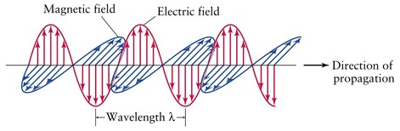
A Radio Wave is an electromagnetic Wave It consists of an Electric Field and a Magnetic Field at right angles to each other.
E
H
E = Electrical Field
H = Magnetic Field

Slide 37
T3B01
What is the relationship between the electric and magnetic fields of an electromagnetic wave?
A. They travel at different speeds
B. They are in parallel
C. They revolve in opposite directions
D. They are at right angles

Slide 38
T3B02
What property of a radio wave defines its polarization?
A. The orientation of the electric field
B. The orientation of the magnetic field
C. The ratio of the energy in the magnetic field to the energy in the electric field
D. The ratio of the velocity to the wavelength

Slide 39
T3B02
What property of a radio wave defines its polarization?
A. The orientation of the electric field
B. The orientation of the magnetic field
C. The ratio of the energy in the magnetic field to the energy in the electric field
D. The ratio of the velocity to the wavelength

Slide 40
T3B03
What are the two components of a radio wave?
A. Impedance and reactance
B. Voltage and current
C. Electric and magnetic fields
D. Ionizing and non-ionizing radiation

Slide 41
T3B03
What are the two components of a radio wave?
A. Impedance and reactance
B. Voltage and current
C. Electric and magnetic fields
D. Ionizing and non-ionizing radiation

Slide 42
T3B04
What is the velocity of a radio wave traveling through free space?
A. Speed of light
B. Speed of sound
C. Speed inversely proportional to its wavelength
D. Speed that increases as the frequency increases

Slide 43
T3B04
What is the velocity of a radio wave traveling through free space?
A. Speed of light
B. Speed of sound
C. Speed inversely proportional to its wavelength
D. Speed that increases as the frequency increases

Slide 44
T3B05
What is the relationship between wavelength and frequency?
A. Wavelength gets longer as frequency increases
B. Wavelength gets shorter as frequency increases
C. Wavelength and frequency are unrelated
D. Wavelength and frequency increase as path length increases

Slide 45

T3B05
What is the relationship between wavelength and frequency?
A. Wavelength gets longer as frequency increases
B. Wavelength gets shorter as frequency increases
C. Wavelength and frequency are unrelated
D. Wavelength and frequency increase as path length increases

Slide 46
T3B06
What is the formula for converting frequency to approximate wavelength in meters?
A. Wavelength in meters equals frequency in hertz multiplied by 300
B. Wavelength in meters equals frequency in hertz divided by 300
C. Wavelength in meters equals frequency in megahertz divided by 300
D. Wavelength in meters equals 300 divided by frequency in megahertz

Slide 47
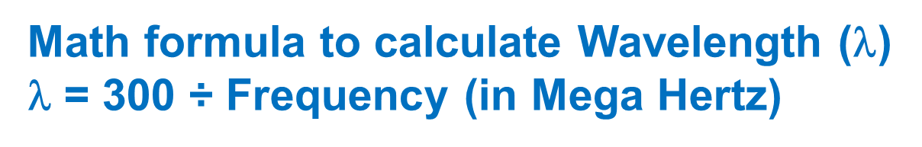
T3B06
What is the formula for converting frequency to approximate wavelength in meters?
A. Wavelength in meters equals frequency in hertz multiplied by 300
B. Wavelength in meters equals frequency in hertz divided by 300
C. Wavelength in meters equals frequency in megahertz divided by 300
D. Wavelength in meters equals 300 divided by frequency in megahertz
Notice the correct answer has 300 in middle not at end

Slide 48
T3B07
In addition to frequency, which of the following is used to identify amateur radio bands?
A. The approximate wavelength in meters
B. Traditional letter/number designators
C. Channel numbers
D. All these choices are correct

Slide 49
T3B07
In addition to frequency, which of the following is used to identify amateur radio bands?
A. The approximate wavelength in meters
B. Traditional letter/number designators
C. Channel numbers
D. All these choices are correct

Slide 50
T3B08
What frequency range is referred to as VHF?
A. 30 kHz to 300 kHz
B. 30 MHz to 300 MHz
C. 300 kHz to 3000 kHz
D. 300 MHz to 3000 MHz

Slide 51
T3B08
What frequency range is referred to as VHF?
A. 30 kHz to 300 kHz LF
B. 30 MHz to 300 MHz VHF
C. 300 kHz to 3000 kHz MF
D. 300 MHz to 3000 MHz UHF
I remember that Ham 2 meter is @ 145MHz or even your FM radio @ 100MHz are VHF that falls between 30 to 300MHz

Slide 52
T3B09
What frequency range is referred to as UHF?
A. 30 to 300 kHz
B. 30 to 300 MHz
C. 300 to 3000 kHz
D. 300 to 3000 MHz

Slide 53
T3B09
What frequency range is referred to as UHF?
A. 30 to 300 kHz LF
B. 30 to 300 MHz VHF
C. 300 to 3000 kHz MF
D. 300 to 3000 MHz UHF
I remember that Ham 2 meter is @ 145MHz or even your FM radio @ 100MHz are VHF that falls between 30 to 300MHz then walk my way UP one group

Slide 54
T3B10
What frequency range is referred to as HF?
A. 300 to 3000 MHz
B. 30 to 300 MHz
C. 3 to 30 MHz
D. 300 to 3000 kHz

Slide 55
T3B10
What frequency range is referred to as HF?
A. 300 to 3000 MHz UHF
B. 30 to 300 MHz VHF
C. 3 to 30 MHz HF
D. 300 to 3000 kHz MF
I remember that Ham 2 meter is @ 145MHz or even your FM radio @ 100MHz are VHF that falls between 30 to 300MHz then walk my way DOWN one group

Slide 56
T3B11
What is the approximate velocity of a radio wave in free space?
A. 150,000 meters per second
B. 300,000,000 meters per second
C. 300,000,000 miles per hour
D. 150,000 miles per hour

Slide 57
T3B11
What is the approximate velocity of a radio wave in free space?
A. 150,000 meters per second
B. 300,000,000 meters per second
C. 300,000,000 miles per hour
D. 150,000 miles per hour

Slide 58
T3C - Propagation modes: sporadic E, meteor scatter, auroral propagation, tropospheric ducting; F region skip; Line of sight and radio horizon
#12 of 35

Slide 59
T3C01
Why are simplex UHF signals rarely heard beyond their radio horizon?
A. They are too weak to go very far
B. FCC regulations prohibit them from going more than 50 miles
C. UHF signals are usually not propagated by the ionosphere
D. UHF signals are absorbed by the ionospheric D region

Slide 60
T3C01
Why are simplex UHF signals rarely heard beyond their radio horizon?
A. They are too weak to go very far
B. FCC regulations prohibit them from going more than 50 miles
C. UHF signals are usually not propagated by the ionosphere (Not Reflected)
D. UHF signals are absorbed by the ionospheric D region (See next Slide)

Slide 61
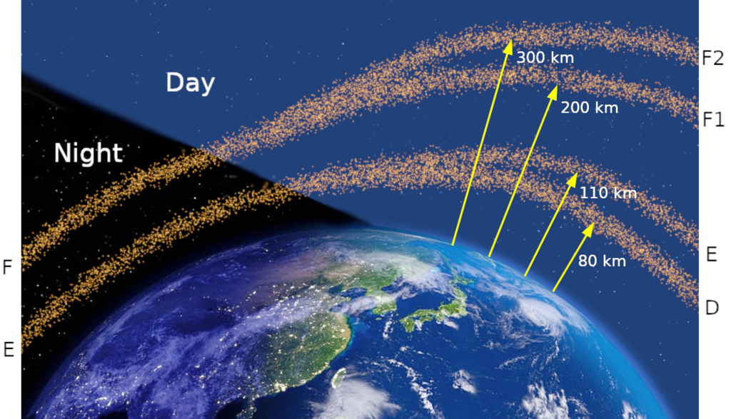
Ionospheric sub-layers from night to day indicating their approximate altitudes. Lower frequency radio waves may reflect (skip) off some layers.

Slide 62
T3C02
What is a characteristic of HF communication compared with communications on VHF and higher frequencies?
A. HF antennas are generally smaller
B. HF accommodates wider bandwidth signals
C. Long-distance ionospheric propagation is far more common on HF
D. There is less atmospheric interference (static) on HF

Slide 63
T3C02
What is a characteristic of HF communication compared with communications on VHF and higher frequencies?
A. HF antennas are generally smaller
B. HF accommodates wider bandwidth signals
C. Long-distance ionospheric propagation is far more common on HF (HF can reflect off ionosphere)
D. There is less atmospheric interference (static) on HF

Slide 64
T3C03
What is a characteristic of VHF signals received via auroral backscatter?
A. They are often received from 10,000 miles or more
B. They are distorted and signal strength varies considerably
C. They occur only during winter nighttime hours
D. They are generally strongest when your antenna is aimed west

Slide 65
T3C03
What is a characteristic of VHF signals received via auroral backscatter?
A. They are often received from 10,000 miles or more
B. They are distorted and signal strength varies considerably
C. They occur only during winter nighttime hours
D. They are generally strongest when your antenna is aimed west
Backscatter is the scattering (reflecting) of waves back towards where it came from.

Slide 66
T3C04
Which of the following types of propagation is most commonly associated with occasional strong signals on the 10, 6, and 2 meter bands from beyond the radio horizon?
A. Backscatter
B. Sporadic E
C. D region absorption
D. Gray-line propagation

Slide 67
T3C04
Which of the following types of propagation is most commonly associated with occasional strong signals on the 10, 6, and 2 meter bands from beyond the radio horizon?
A. Backscatter
B. Sporadic E
C. D region absorption
D. Gray-line propagation
(See next slide)

Slide 68
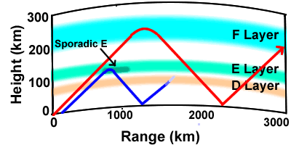
Sporadic E is an unusual form of radio propagation using characteristics of the Earth's ionosphere. Whereas most forms of skywave propagation use the normal ionization properties of the ionosphere

Slide 69
T3C05
Which of the following effects may allow radio signals to travel beyond obstructions between the transmitting and receiving stations?
A. Knife-edge diffraction
B. Faraday rotation
C. Quantum tunneling
D. Doppler shift

Slide 70
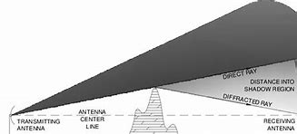
T3C05
Which of the following effects may allow radio signals to travel beyond obstructions between the transmitting and receiving stations?
A. Knife-edge diffraction
B. Faraday rotation
C. Quantum tunneling
D. Doppler shift

Slide 71
T3C06
What type of propagation is responsible for allowing over-the-horizon VHF and UHF communications to ranges of approximately 300 miles on a regular basis?
A. Tropospheric ducting
B. D region refraction
C. F2 region refraction
D. Faraday rotation

Slide 72
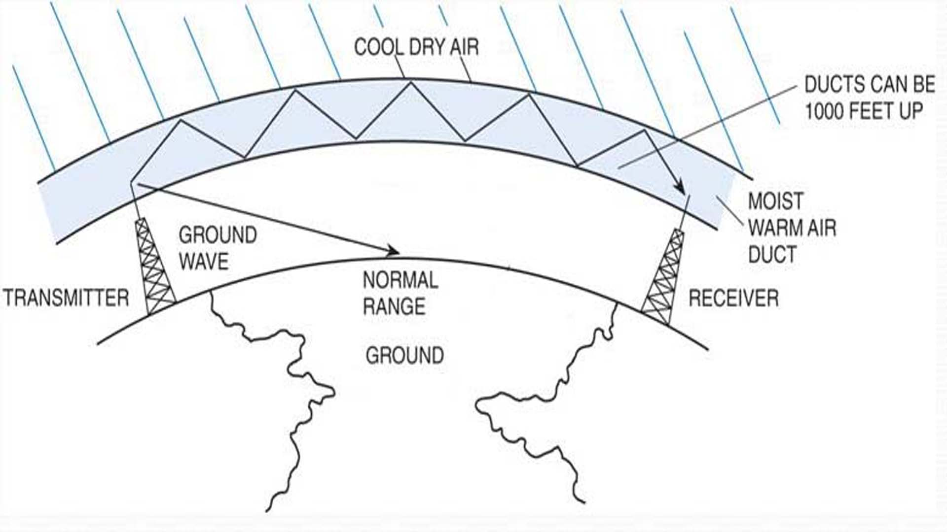
T3C06
What type of propagation is responsible for allowing over-the-horizon VHF and UHF communications to ranges of approximately 300 miles on a regular basis?
A. Tropospheric ducting
B. D region refraction
C. F2 region refraction
D. Faraday rotation

Slide 73
T3C07
What band is best suited for communicating via meteor scatter?
A. 33 centimeters
B. 6 meters
C. 2 meters
D. 70 centimeters

Slide 74
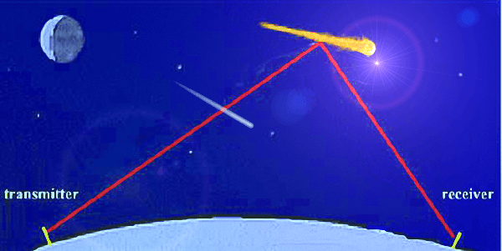
T3C07
What band is best suited for communicating via meteor scatter?
A. 33 centimeters
B. 6 meters
C. 2 meters
D. 70 centimeters

Slide 75
T3C08
What causes tropospheric ducting?
A. Discharges of lightning during electrical storms
B. Sunspots and solar flares
C. Updrafts from hurricanes and tornadoes
D. Temperature inversions in the atmosphere

Slide 76

T3C08
What causes tropospheric ducting?
A. Discharges of lightning during electrical storms
B. Sunspots and solar flares
C. Updrafts from hurricanes and tornadoes
D. Temperature inversions in the atmosphere

Slide 77
T3C09
What is generally the best time for long-distance 10 meter band propagation via the F region?
A. From dawn to shortly after sunset during periods of high sunspot activity
B. From shortly after sunset to dawn during periods of high sunspot activity
C. From dawn to shortly after sunset during periods of low sunspot activity
D. From shortly after sunset to dawn during periods of low sunspot activity

Slide 78
T3C09
What is generally the best time for long-distance 10 meter band propagation via the F region?
A. From dawn to shortly after sunset during periods of high sunspot activity
B. From shortly after sunset to dawn during periods of high sunspot activity
C. From dawn to shortly after sunset during periods of low sunspot activity
D. From shortly after sunset to dawn during periods of low sunspot activity
The F layer Changes position between day and night (Lower at night)

Slide 79
T3C10
Which of the following bands may provide long-distance communications via the ionosphere’s F region during the peak of the sunspot cycle?
A. 6 and 10 meters
B. 23 centimeters
C. 70 centimeters and 1.25 meters
D. All these choices are correct

Slide 80
T3C10
Which of the following bands may provide long-distance communications via the ionosphere’s F region during the peak of the sunspot cycle?
A. 6 and 10 meters
B. 23 centimeters
C. 70 centimeters and 1.25 meters
D. All these choices are correct
The lower the Ionospheric layers the better the skip
Sun Spots also push the Ionospheric layers down.

Slide 81
T3C11
Why is the radio horizon for VHF and UHF signals more distant than the visual horizon?
A. Radio signals move somewhat faster than the speed of light
B. Radio waves are not blocked by dust particles
C. The atmosphere refracts radio waves slightly
D. Radio waves are blocked by dust particles

Slide 82
T3C11
Why is the radio horizon for VHF and UHF signals more distant than the visual horizon?
A. Radio signals move somewhat faster than the speed of light
B. Radio waves are not blocked by dust particles
C. The atmosphere refracts radio waves slightly
D. Radio waves are blocked by dust particles

Slide 83
End of Sub-element 3
(34% completed)
Proceed to Sub-element 4 when ready

